Slide 1

Title: Bootstrapping in Compilers CSA1407: COMPILER DESIGN
Guided by:
Dr.N.Deepa
Presented by:
P.Pallavi
192525448

Slide 2
Introduction:
Bootstrapping is the process of developing a compiler using the same programming language that the compiler is intended to compile.
It allows a compiler to compile newer versions of itself.
It is an important technique used in modern compiler development.
Example: A C compiler written in C.

Slide 3
Core Concepts:
Compiler in Same Language
Compiler is written using the language it compiles.
Easier to develop and maintain.
Self-Hosting
Compiler compiles its own source code.
Enables continuous improvement.

Slide 4
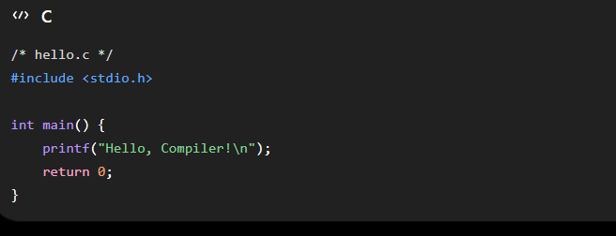
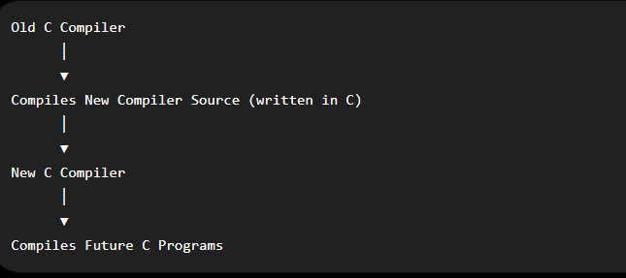
WORKING OF BOOTSTRAPPING:

Slide 5
Advantages:
Portability
Easy to adapt to different platforms.
Requires minimal changes.
Modern Usage
Used in advanced compiler development.
Supports new features and optimizations.

Slide 6
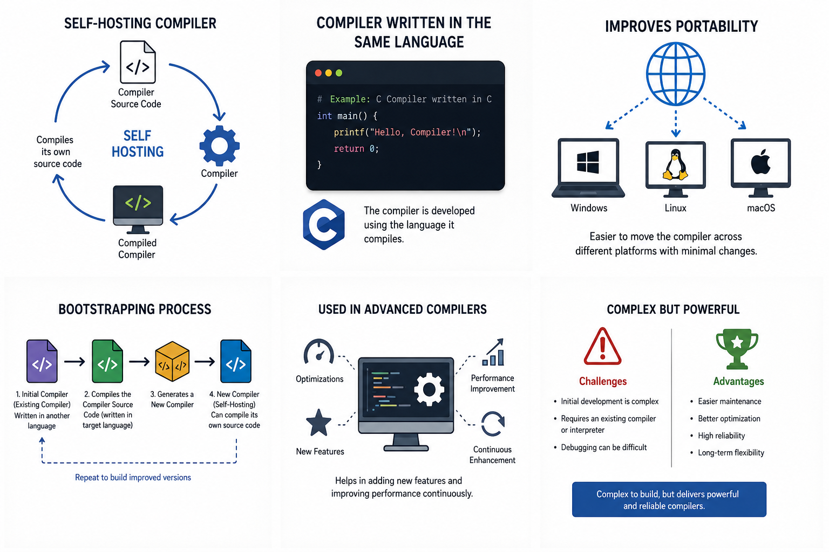
Conclusion:
Compiler can compile itself.
Supports portability and
self-hosting.
Powerful technique in
modern compiler design.

Slide 7
